Slide 1
Bert for Gendered Pronoun Resolution
Gong Qiong
2019.06.05

Slide 2
Outline
Problem
Self-Attention
Transformer
BERT
Fine-tune BERT

Slide 3
Outline
Problem
Self-Attention
Transformer
BERT
Fine-tune BERT

Slide 4
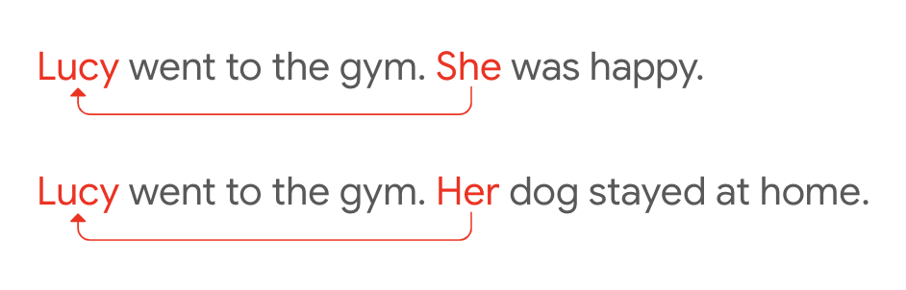
Problem
Coreference Resolution
Coreference Resolution is the task of identifying clusters of mentions referring to the same real-world entity
Pronoun Resolution
task of identifying for a specified pronoun in a passage, which named entity antecedent it refers to.

Slide 5
Problem
Example of Gendered Pronoun Resolution
Kathleen Nott was born in Camberwell, London. Her father, Philip, was a lithographic printer, and her mother, Ellen, ran a boarding house in Brixton; Kathleen was their third daughter. She was educated at Mary Datchelor Girls’ School (now closed), London, before attending King’s College, London.
Target pronoun: She,Candidate A: Ellen, Candidate B: Kathleen
Ground Truth Class (one of A, B or NEITHER): Kathleen

Slide 6
Outline
Problem
Self-attention
Transformer
BERT
Fine-tune BERT

Slide 7
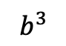
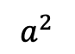
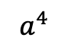
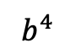
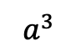
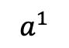
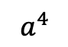
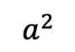
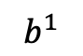
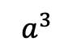
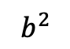
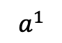
RNN for Sequence
Next layer
$$b^{1}$$
$$b^{2}$$
$$b^{3}$$
$$b^{4}$$
$$a^{1}$$
$$a^{2}$$
$$a^{3}$$
$$a^{4}$$
$$a^{1}$$
$$a^{2}$$
$$a^{3}$$
$$a^{4}$$
Previous layer
Using CNN to replace RNN
Hard to parallel !

Slide 8
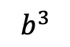
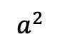
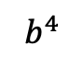
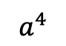
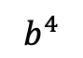
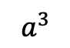
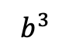
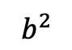
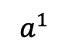
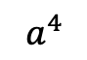
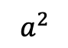
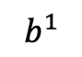
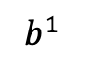
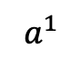
Sequence
Filters in higher layer can consider longer sequence
Next layer
$$b^{1}$$
$$b^{2}$$
$$b^{3}$$
$$b^{4}$$
$$b^{1}$$
$$b^{2}$$
$$b^{3}$$
$$b^{4}$$
……
……
……
……
Filter
$$a^{1}$$
$$a^{2}$$
$$a^{3}$$
$$a^{4}$$
$$a^{1}$$
$$a^{2}$$
$$a^{3}$$
$$a^{4}$$
Previous layer
Using CNN to replace RNN
Hard to parallel
(CNN can parallel)

Slide 9

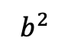
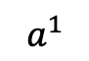
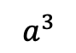
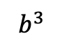
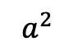
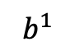
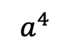
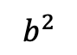
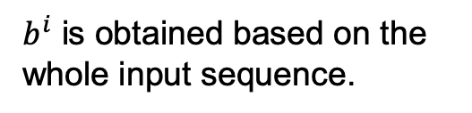
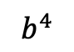
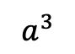
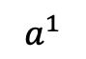
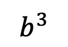
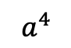
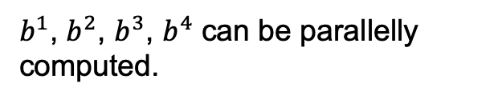
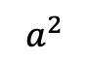
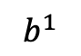
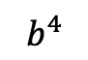
Self-Attention
$b^{i}$ is obtained based on the whole input sequence.
$b^{1}$, $b^{2}$, $b^{3}$, $b^{4}$ can be parallelly computed.
$$b^{1}$$
$$b^{2}$$
$$b^{3}$$
$$b^{4}$$
$$b^{1}$$
$$b^{2}$$
$$b^{3}$$
$$b^{4}$$
Self-Attention Layer
$$a^{1}$$
$$a^{2}$$
$$a^{3}$$
$$a^{4}$$
$$a^{1}$$
$$a^{2}$$
$$a^{3}$$
$$a^{4}$$
You can try to replace any thing that has been done by RNN with self-attention.

Slide 10
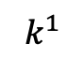
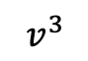
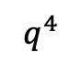
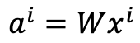
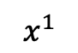





















Self-Attention
$q$: query (to match others)
$$q^{i}=W^{q}a^{i}$$
Attention is all you need.
$k$: key (to be matched)
$$k^{i}=W^{k}a^{i}$$
$v$: information to be extracted
https://arxiv.org/abs/1706.03762
$$v^{i}=W^{v}a^{i}$$
$$q^{1}$$
$$k^{1}$$
$$v^{1}$$
$$q^{2}$$
$$k^{2}$$
$$v^{2}$$
$$q^{3}$$
$$k^{3}$$
$$v^{3}$$
$$q^{4}$$
$$k^{4}$$
$$v^{4}$$
$$a^{1}$$
$$a^{2}$$
$$a^{3}$$
$$a^{4}$$
$$a^{i}=Wx^{i}$$
$$x^{1}$$
$$x^{2}$$
$$x^{3}$$
$$x^{4}$$

Slide 11






Self-Attention
d is the dim of $q$ and $k$
Scaled Dot-Product Attention:
$$α_{1,i}=q^{1}∙k^{i}/\sqrt{d}$$
dot product
$$α_{1,1}$$
$$α_{1,2}$$
$$α_{1,3}$$
$$α_{1,4}$$
$$q^{1}$$
$$k^{1}$$
$$v^{1}$$
$$q^{2}$$
$$k^{2}$$
$$v^{2}$$
$$q^{3}$$
$$k^{3}$$
$$v^{3}$$
$$q^{4}$$
$$k^{4}$$
$$v^{4}$$
$$a^{1}$$
$$a^{2}$$
$$a^{3}$$
$$a^{4}$$
$$x^{1}$$
$$x^{2}$$
$$x^{3}$$
$$x^{4}$$

Slide 12





Self-Attention
$${\hat{α}}_{1,i}=exp\left(α_{1,i} \right)/\sum_{j}{exp\left(α_{1,j} \right)}$$
$${\hat{α}}_{1,1}$$
$${\hat{α}}_{1,2}$$
$${\hat{α}}_{1,3}$$
$${\hat{α}}_{1,4}$$
Soft-max
$$α_{1,1}$$
$$α_{1,2}$$
$$α_{1,3}$$
$$α_{1,4}$$
$$q^{1}$$
$$k^{1}$$
$$v^{1}$$
$$q^{2}$$
$$k^{2}$$
$$v^{2}$$
$$q^{3}$$
$$k^{3}$$
$$v^{3}$$
$$q^{4}$$
$$k^{4}$$
$$v^{4}$$
$$a^{1}$$
$$a^{2}$$
$$a^{3}$$
$$a^{4}$$
$$x^{1}$$
$$x^{2}$$
$$x^{3}$$
$$x^{4}$$

Slide 13






Self-Attention
$$b^{1}=\sum_{i}{{\hat{α}}_{1,i}v^{i} }$$
Considering the whole sequence
$$b^{1}$$
$${\hat{α}}_{1,1}$$
$${\hat{α}}_{1,2}$$
$${\hat{α}}_{1,3}$$
$${\hat{α}}_{1,4}$$
$$q^{1}$$
$$k^{1}$$
$$v^{1}$$
$$q^{2}$$
$$k^{2}$$
$$v^{2}$$
$$q^{3}$$
$$k^{3}$$
$$v^{3}$$
$$q^{4}$$
$$k^{4}$$
$$v^{4}$$
$$a^{1}$$
$$a^{2}$$
$$a^{3}$$
$$a^{4}$$
$$x^{1}$$
$$x^{2}$$
$$x^{3}$$
$$x^{4}$$
Notes:
Relation between attention and CNN
Global receptive field (compared to convolutional architectures)

Slide 14






Self-Attention
$$b^{2}=\sum_{i}{{\hat{α}}_{2,i}v^{i} }$$
$$b^{2}$$
$${\hat{α}}_{2,1}$$
$${\hat{α}}_{2,2}$$
$${\hat{α}}_{2,3}$$
$${\hat{α}}_{2,4}$$
$$q^{1}$$
$$k^{1}$$
$$v^{1}$$
$$q^{2}$$
$$k^{2}$$
$$v^{2}$$
$$q^{3}$$
$$k^{3}$$
$$v^{3}$$
$$q^{4}$$
$$k^{4}$$
$$v^{4}$$
$$a^{1}$$
$$a^{2}$$
$$a^{3}$$
$$a^{4}$$
$$x^{1}$$
$$x^{2}$$
$$x^{3}$$
$$x^{4}$$
Notes:
Relation between attention and CNN
Global receptive field (compared to convolutional architectures)

Slide 15




Self-Attention
$b^{1}$, $b^{2}$, $b^{3}$, $b^{4}$ can be parallelly computed.
$$b^{1}$$
$$b^{2}$$
$$b^{3}$$
$$b^{4}$$
Self-Attention Layer
$$a^{1}$$
$$a^{2}$$
$$a^{3}$$
$$a^{4}$$
$$x^{1}$$
$$x^{2}$$
$$x^{3}$$
$$x^{4}$$
Notes:
Relation between attention and CNN
Global receptive field (compared to convolutional architectures)

Slide 16


































Self-Attention
$$q^{1}$$
$$q^{2}$$
$$q^{3}$$
$$q^{4}$$
$$a^{1}$$
$$a^{2}$$
=
$$a^{3}$$
$$W^{q}$$
$$a^{4}$$
$$Q$$
$$I$$
$$a^{1}$$
$$a^{2}$$
$$k^{1}$$
$$a^{3}$$
$$k^{2}$$
$$a^{4}$$
$$k^{3}$$
$$q^{i}=W^{q}a^{i}$$
$$k^{4}$$
=
$$W^{k}$$
$$K$$
$$I$$
$$k^{i}=W^{k}a^{i}$$
$$a^{1}$$
$$a^{2}$$
$$a^{3}$$
$$v^{1}$$
$$a^{4}$$
$$v^{2}$$
$$v^{3}$$
$$v^{4}$$
=
$$W^{v}$$
$$v^{i}=W^{v}a^{i}$$
$$V$$
$$I$$
$$q^{1}$$
$$k^{1}$$
$$v^{1}$$
$$q^{2}$$
$$k^{2}$$
$$v^{2}$$
$$q^{3}$$
$$k^{3}$$
$$v^{3}$$
$$q^{4}$$
$$k^{4}$$
$$v^{4}$$
$$a^{1}$$
$$a^{2}$$
$$a^{3}$$
$$a^{4}$$
$$x^{1}$$
$$x^{2}$$
$$x^{3}$$
$$x^{4}$$

Slide 17




















Self-Attention
$$b^{1}$$
$${\hat{α}}_{1,1}$$
$${\hat{α}}_{1,2}$$
$${\hat{α}}_{1,3}$$
$${\hat{α}}_{1,4}$$
$$q^{1}$$
$$k^{1}$$
$$v^{1}$$
$$q^{2}$$
$$k^{2}$$
$$v^{2}$$
$$q^{3}$$
$$k^{3}$$
$$v^{3}$$
$$q^{4}$$
$$k^{4}$$
$$v^{4}$$
$$α_{1,1}=$$
$$k^{1}$$
$$q^{1}$$
$$α_{1,2}=$$
$$k^{2}$$
$$q^{1}$$
$$α_{1,1}$$
$$k^{1}$$
$$α_{1,2}$$
$$k^{2}$$
$$α_{1,3}=$$
$$k^{3}$$
$$q^{1}$$
$$α_{1,4}=$$
$$k^{4}$$
$$q^{1}$$
$$=$$
$$q^{1}$$
$$α_{1,3}$$
$$k^{3}$$
$$α_{1,4}$$
$$k^{4}$$
(ignore $\sqrt{d}$ for simplicity)
Notes:
Relation between attention and CNN
Global receptive field (compared to convolutional architectures)

Slide 18













































Self-Attention
$$b^{2}=\sum_{i}{{\hat{α}}_{2,i}v^{i} }$$
$$b^{2}$$
$${\hat{α}}_{2,1}$$
$${\hat{α}}_{2,2}$$
$${\hat{α}}_{2,3}$$
$${\hat{α}}_{2,4}$$
$$q^{1}$$
$$k^{1}$$
$$v^{1}$$
$$q^{2}$$
$$k^{2}$$
$$v^{2}$$
$$q^{3}$$
$$k^{3}$$
$$v^{3}$$
$$q^{4}$$
$$k^{4}$$
$$v^{4}$$
$${\hat{α}}_{1,1}$$
$${\hat{α}}_{2,1}$$
$${\hat{α}}_{3,1}$$
$${\hat{α}}_{4,1}$$
$$α_{1,1}$$
$$α_{2,1}$$
$$α_{3,1}$$
$$α_{4,1}$$
$$k^{1}$$
$${\hat{α}}_{1,2}$$
$${\hat{α}}_{2,2}$$
$${\hat{α}}_{3,2}$$
$${\hat{α}}_{4,2}$$
$$α_{1,2}$$
$$α_{2,2}$$
$$α_{3,2}$$
$$α_{4,2}$$
$$k^{2}$$
$${\hat{α}}_{1,3}$$
$${\hat{α}}_{2,3}$$
$${\hat{α}}_{3,3}$$
$$=$$
$$q^{1}$$
$$q^{2}$$
$$q^{3}$$
$$q^{4}$$
$${\hat{α}}_{4,3}$$
$$α_{1,3}$$
$$α_{2,3}$$
$$α_{3,3}$$
$$α_{4,3}$$
$$k^{3}$$
$${\hat{α}}_{1,4}$$
$${\hat{α}}_{2,4}$$
$${\hat{α}}_{3,4}$$
$${\hat{α}}_{4,4}$$
$$α_{1,4}$$
$$α_{2,4}$$
$$α_{3,4}$$
$$α_{4,4}$$
$$k^{4}$$
$$Q$$
$$\hat{A}$$
$$A$$
$$K^{T}$$
Notes:
Relation between attention and CNN
Global receptive field (compared to convolutional architectures)

Slide 19

























Self-Attention
$$b^{2}=\sum_{i}{{\hat{α}}_{2,i}v^{i} }$$
$$b^{2}$$
$${\hat{α}}_{2,1}$$
$${\hat{α}}_{2,2}$$
$${\hat{α}}_{2,3}$$
$${\hat{α}}_{2,4}$$
$$q^{1}$$
$$k^{1}$$
$$v^{1}$$
$$q^{2}$$
$$k^{2}$$
$$v^{2}$$
$$q^{3}$$
$$k^{3}$$
$$v^{3}$$
$$q^{4}$$
$$k^{4}$$
$$v^{4}$$
$${\hat{α}}_{1,1}$$
$${\hat{α}}_{2,1}$$
$${\hat{α}}_{3,1}$$
$${\hat{α}}_{4,1}$$
$${\hat{α}}_{1,2}$$
$${\hat{α}}_{2,2}$$
$${\hat{α}}_{3,2}$$
$${\hat{α}}_{4,2}$$
$$b^{1}$$
=
$$b^{2}$$
$$b^{3}$$
$$b^{4}$$
$$v^{1}$$
$$v^{2}$$
$$v^{3}$$
$$v^{4}$$
$${\hat{α}}_{1,3}$$
$${\hat{α}}_{2,3}$$
$${\hat{α}}_{3,3}$$
$${\hat{α}}_{4,3}$$
$$O$$
$$V$$
$${\hat{α}}_{1,4}$$
$${\hat{α}}_{2,4}$$
$${\hat{α}}_{3,4}$$
$${\hat{α}}_{4,4}$$
$$\hat{A}$$
Notes:
Relation between attention and CNN
Global receptive field (compared to convolutional architectures)

Slide 20



















Self-Attention
$$O$$
$$Q$$
=
$$I$$
$$W^{q}$$
$$K$$
=
$$I$$
$$W^{k}$$
$$V$$
=
$$I$$
$$I$$
$$W^{v}$$
$$\hat{A}$$
$$A$$
=
$$Q$$
$$K^{T}$$
$$\hat{A}$$
$$O$$
=
$$V$$

Slide 21
























Multi-head Self-Attention
(2 heads as example)
$$q^{i,1}=W^{q,1}q^{i}$$
$$b^{i,1}$$
$$q^{i,2}=W^{q,2}q^{i}$$
$$q^{i,1}$$
$$q^{i,2}$$
$$k^{i,1}$$
$$k^{i,2}$$
$$v^{i,1}$$
$$v^{i,2}$$
$$q^{j,1}$$
$$q^{j,2}$$
$$k^{j,1}$$
$$k^{j,2}$$
$$v^{j,1}$$
$$v^{j,2}$$
$$q^{i}$$
$$k^{i}$$
$$v^{i}$$
$$q^{j}$$
$$k^{j}$$
$$v^{j}$$
$$q^{i}=W^{q}a^{i}$$
$$a^{i}$$
$$a^{j}$$

Slide 22




Multi-head Self-Attention
$$b^{i,1}$$
(2 heads as example)
$$b^{i,2}$$
$$q^{i,1}=W^{q,1}q^{i}$$
$$q^{i,2}=W^{q,2}q^{i}$$
$$v^{j,1}$$
$$k^{j,1}$$
$$v^{j,1}$$
$$q^{j,1}$$
$$k^{j,1}$$
$$q^{j,1}$$
$$v^{j,2}$$
$$k^{j,2}$$
$$v^{j,2}$$
$$q^{j,2}$$
$$k^{j,2}$$
$$v^{i,1}$$
$$q^{j,2}$$
$$k^{i,1}$$
$$v^{i,1}$$
$$q^{i,1}$$
$$k^{i,1}$$
$$v^{i,2}$$
$$k^{i,2}$$
$$v^{i,2}$$
$$q^{i,2}$$
$$k^{i,2}$$
$$q^{i}$$
$$k^{i}$$
$$v^{i}$$
$$q^{j}$$
$$k^{j}$$
$$v^{j}$$
$$q^{i}=W^{q}a^{i}$$
$$a^{i}$$
$$a^{j}$$

Slide 23





Multi-head Self-Attention
(2 heads as example)
$$b^{i,1}$$
$$b^{i}$$
$$b^{i,1}$$
$$b^{i,2}$$
$$b^{i}$$
=
$$W^{O}$$
$$b^{i,2}$$
$$q^{i,1}$$
$$q^{i,2}$$
$$k^{i,1}$$
$$k^{i,2}$$
$$v^{i,1}$$
$$v^{i,2}$$
$$q^{j,1}$$
$$q^{j,2}$$
$$k^{j,1}$$
$$k^{j,2}$$
$$v^{j,1}$$
$$v^{j,2}$$
$$q^{i}$$
$$k^{i}$$
$$v^{i}$$
$$q^{j}$$
$$k^{j}$$
$$v^{j}$$
$$a^{i}$$
$$a^{j}$$

Slide 24
Outline
Problem
Self-Attention
Transformer
BERT
Evaluation

Slide 25














Seq2seq with Attention
Review: https://www.youtube.com/watch?v=ZjfjPzXw6og&feature=youtu.be
$$c^{1}$$
$$c^{2}$$
$$o^{1}$$
$$o^{2}$$
$$o^{3}$$
$$h^{1}$$
$$h^{2}$$
$$h^{3}$$
$$h^{4}$$
Self-Attention Layer
Self-Attention Layer
$$x^{1}$$
$$x^{2}$$
$$x^{3}$$
$$x^{4}$$
$$c^{1}$$
$$c^{2}$$
$$c^{3}$$
Encoder
Decoder

Slide 26



















Positional Encoding
$$q^{i}$$
$$k^{i}$$
$$v^{i}$$
No position information in self-attention.
Original paper: each position has a unique positional vector $e^{i}$ (not learned from data)
In other words: each $x^{i}$ appends a one-hot vector $p^{i}$
$$e^{i}$$
+
$$a^{i}$$
$$x^{i}$$
$$x^{i}$$
$$a^{i}$$
$$W$$
=
$$W^{I}$$
$$x^{i}$$
$$p^{i}$$
$$W^{I}$$
$$W^{P}$$
………
$$p^{i}=$$
0
$$e^{i}$$
1
i-th dim
$$W^{P}$$
+
$$p^{i}$$
0
…

Slide 27











$$x^{i}$$
$$W$$
$$p^{i}$$
$$W^{I}$$
$$W^{P}$$
$$a^{i}$$
=
$$W^{I}$$
$$x^{i}$$
$$e^{i}$$
+
$$W^{P}$$
$$p^{i}$$
-1
1
source of image: http://jalammar.github.io/illustrated-transformer/

Slide 28
Outline
Problem
Gender Bias
Transformer
BERT
Evaluation

Slide 29

https://ai.googleblog.com/2017/08/transformer-novel-neural-network.html

Slide 30

BERT-Transformer
machine
learning
Using Chinese to English translation as example
Encoder
Decoder
機 器 學 習
<BOS>
machine

Slide 31





Layer Norm:
https://arxiv.org/abs/1607.06450
Batch Size
Layer
Norm
$$b^{′}$$
Batch Norm:
$$μ=0,$$
$$σ=1$$
https://www.youtube.com/watch?v=BZh1ltr5Rkg
+
Batch
$$b$$
$$μ=0,σ=1$$
Layer
…
$$a$$
attend on the input sequence
Masked: attend on the generated sequence
Notes:
(two layer2, with one relu)

Slide 32

Attention Visualization
https://arxiv.org/abs/1706.03762

Slide 33

Attention Visualization
The encoder self-attention distribution for the word “it” from the 5th to the 6th layer of a Transformer trained on English to French translation (one of eight attention heads).
https://ai.googleblog.com/2017/08/transformer-novel-neural-network.html

Slide 34


Multi-head Attention Visualization

Slide 35
Outline
Problem
Self-Attention
Transformer
BERT
Fine-tune BERT

Slide 36
Fine-tune BERT

Slide 37
Fine-tune BERT

Slide 38
References
Soon, Wee Meng, Hwee Tou Ng, and Daniel Chung Yong Lim. "A machine learning approach to coreference resolution of noun phrases." Computational linguistics 27.4 (2001): 521-544.
Vaswani, Ashish, et al. "Attention is all you need." Advances in neural information processing systems. 2017.
Devlin, Jacob, et al. "Bert: Pre-training of deep bidirectional transformers for language understanding." arXiv preprint arXiv:1810.04805 (2018).

